Slide 1
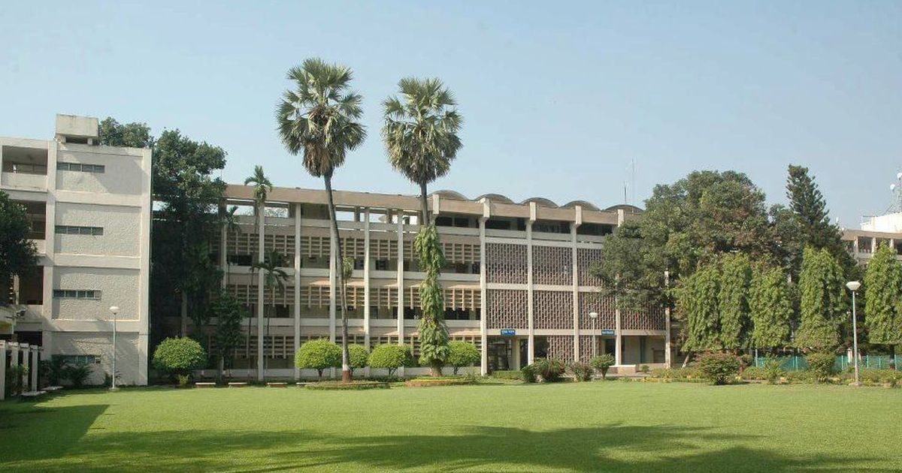


M. Tech & Ph.D.
Orientation
Welcome
to the
Civil Engineering Department

Slide 2






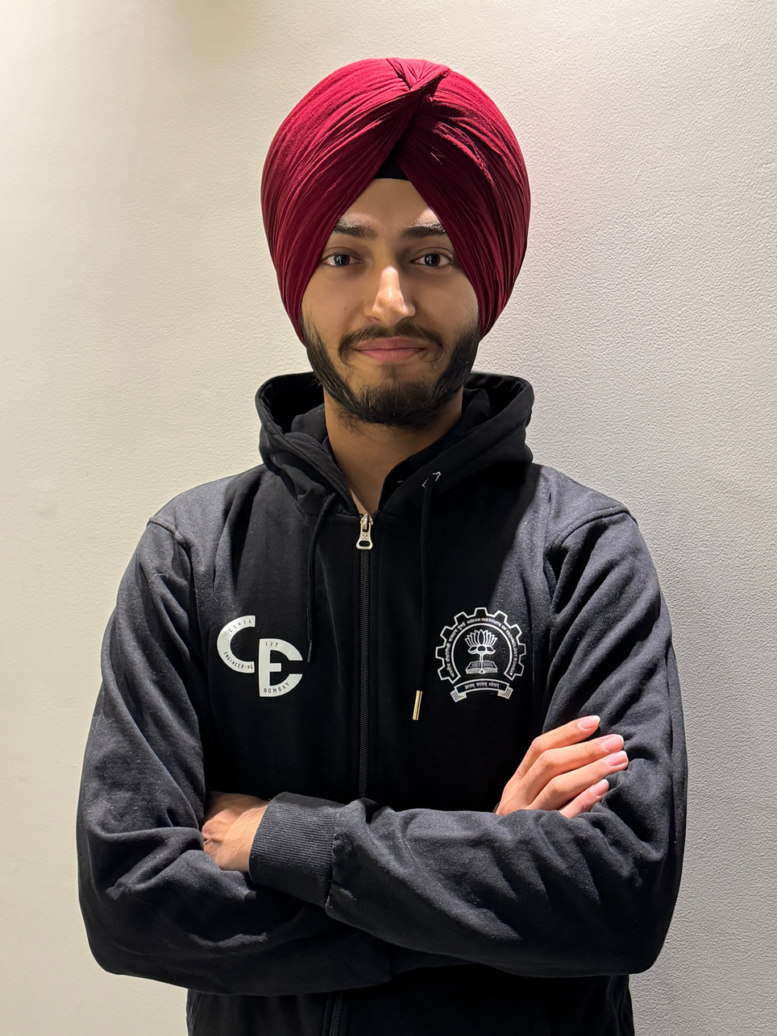





Gursheel Singh
Department General Secretary
EMAIL
dgsec@civil.iitb.ac.in

Slide 3


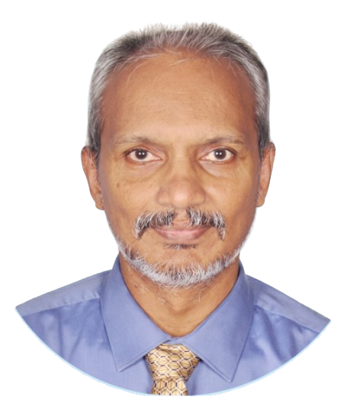
HOD
HEAD OF
DEPARTMENT
Prof. Tom V Mathew
Transportation Systems Engineering
EMAIL
hod@civil.iitb.ac.in

Slide 4

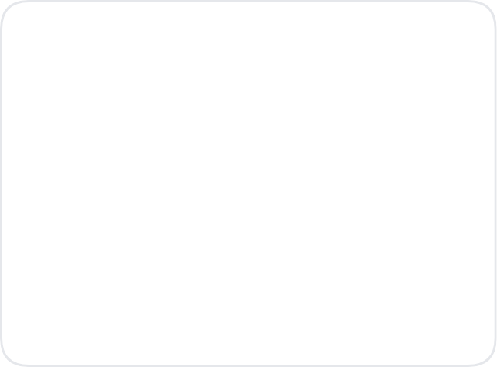






IIT Bombay and Civil Engineering Department
IIT Bombay
Student Strength
Total: ~1103
Autonomous Institution
Under MoE
Act of Parliament
Total Papers
1,364
657
B.Tech
174
M.Tech
272
Ph.D
Last 5 Years
Civil Department
Established - 1958
QS World Ranking
Patents (5 Years)
Faculty - 60+
Civil & Structural
Applied / Filed 20
Ranked 42 Globally
Staff - 28+
Ranked 1 in India
Granted 18
Programs
B.Tech in Civil Engg.
MTech in 7 Specializations
Ph.D. in all Areas of CE +
2

Slide 5



Publication Details & Rankings
SCI Journals (2016-2025)
Total: 2270
Citations of Publications
Consistent growth in research impact
Impact Factor
Consistently increasing citation counts indicate growing global influence of departmental research.
Source: Dept. Review Report (2023)

Slide 6

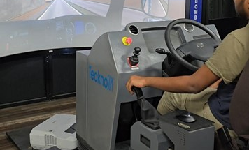
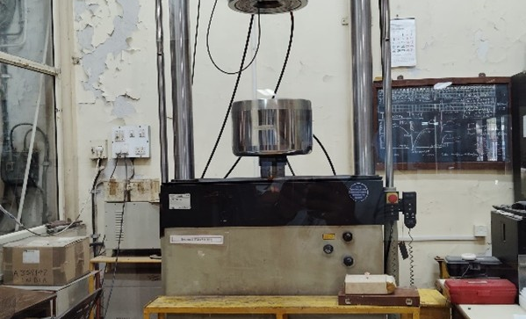
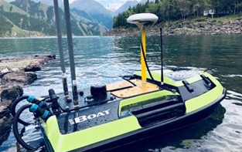
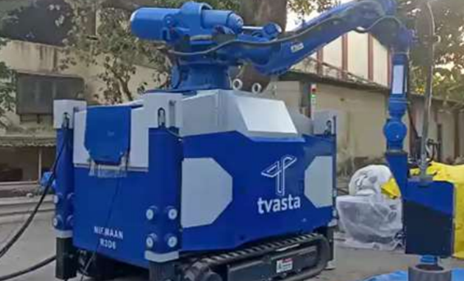
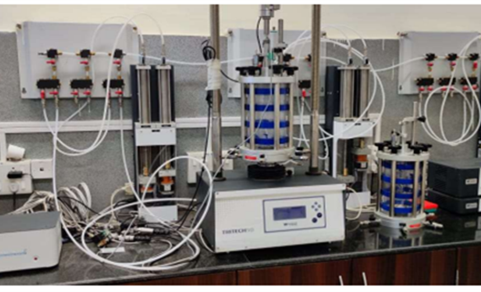





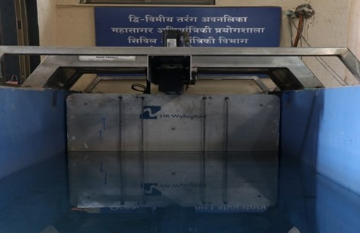
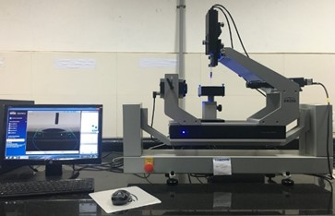
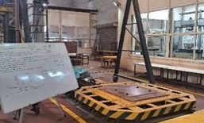
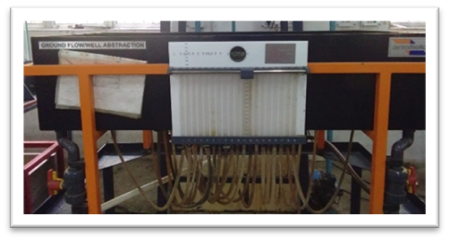
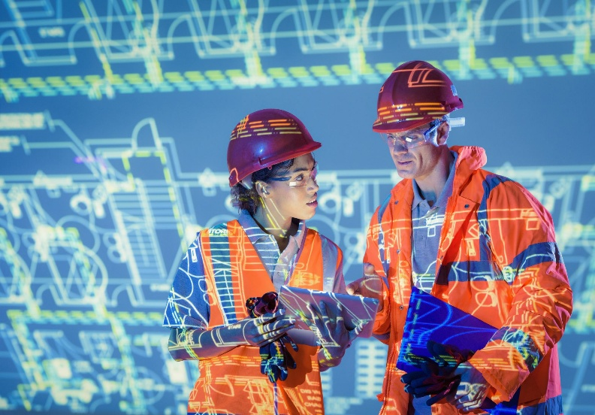




Infrastructure & Capabilities: Major Equipment
Investment Summary (Last 5 Years)
21
₹ 24.31 Crore
Continuous upgradation of research infrastructure
Instruments >20 Lakhs
Total Investment Cost
Driving Simulator
Universal Testing Machine
Unmanned Boat
3D Printer
Triaxial System
2D Wave Maker
Drop Shape Analyser
Shake Table
Ground Water Flow
Future Expansion

Slide 7





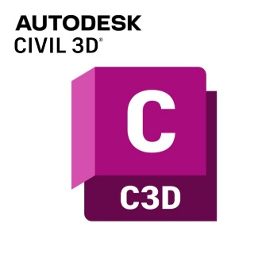



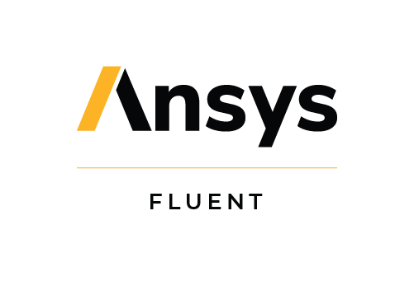












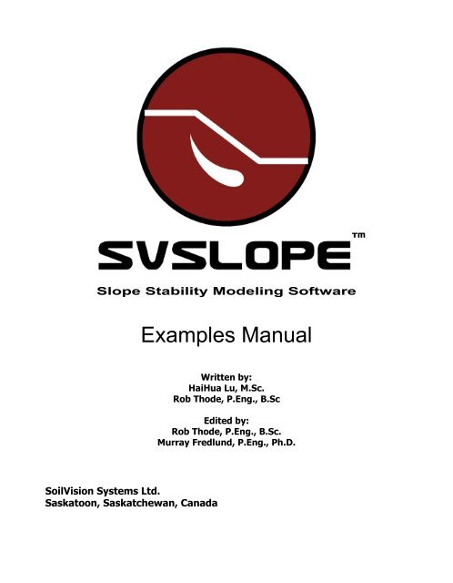













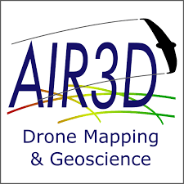





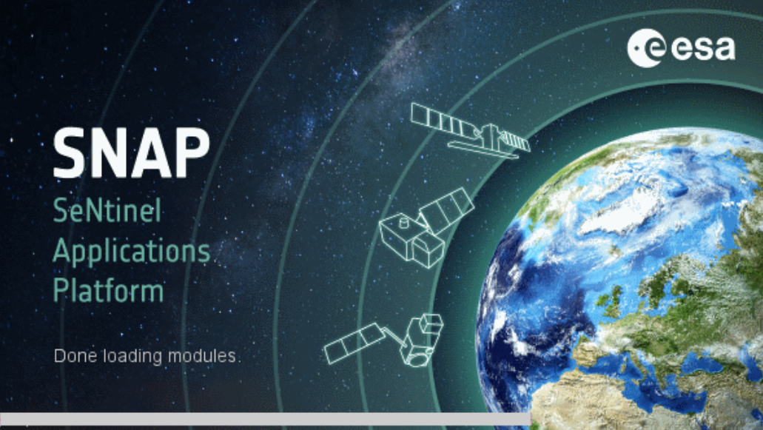



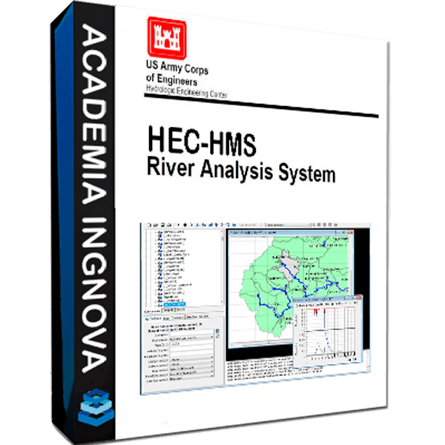

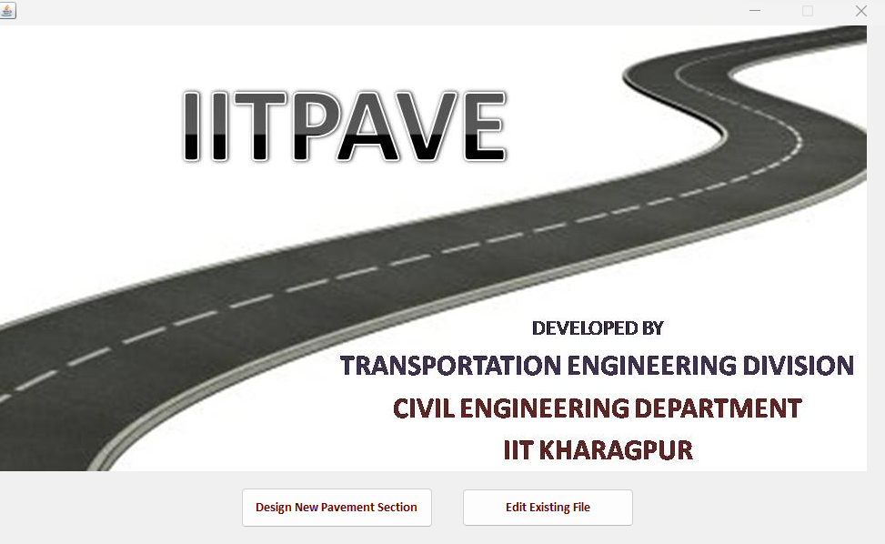






Software Capabilities

Slide 8




























Academic Research Partnerships & Collaborations

Slide 9

















































Industry Partnerships & Collaborations

Slide 10
Key Initiatives
Integrated Design Project
Credit Based Industry Internship
Alumni Engagement
Curriculum Review
Outreach Programs

Slide 11







Group specializations
Transportation Systems Engineering
Geotechnical Engineering
Water Resources Engineering
Structural Engineering
Ocean Engineering
Remote Sensing
Construction Technology And Management
www.civil.iitb.ac.in/faculty

Slide 12
Best Practices
M. Tech
  Faculty Advisors – I Year
  Supervisor – II Year
  Complete Course Year I
  Dissertation
  Reach out !!!
Ph.D.
  Supervisor
  Research Topics
  Research Progress Committee
  Qualifier, Registration
  Annual Progress Seminar
  Course completion
  Funding and Approvals

Slide 13
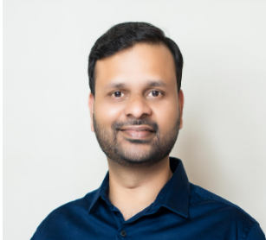
Prof. Sangram Nirmale
Transportation Systems Engineering
EMAIL
sangramnirmale@civil.iitb.ac.in

Slide 14
Transportation Systems Engineering
(TSE) – CE 1

Slide 15


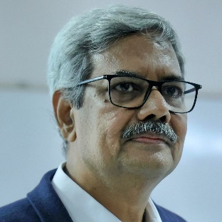
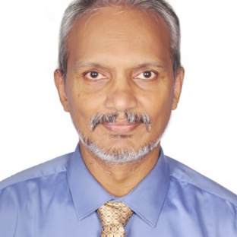
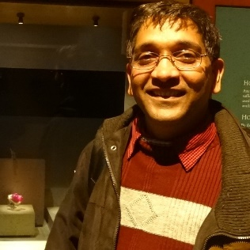
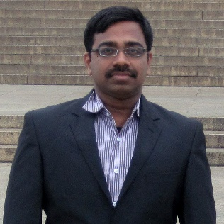
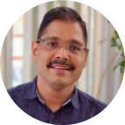
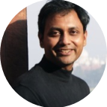


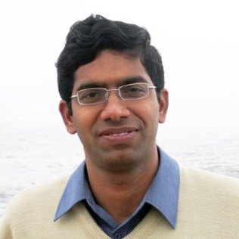
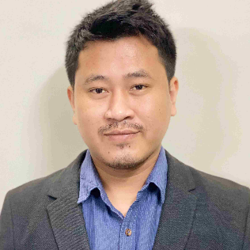



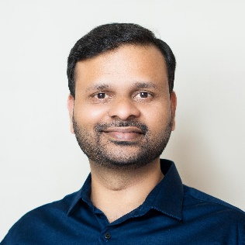
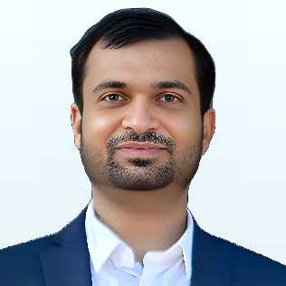

CE1
Transportation Systems Engineering – TSE
Faculty, Research & Achievements
Faculty Members
10 Members
Research Areas
Prof. K V Krishna Rao
Prof. Tom V. Mathew
Transportation Planning & Travel Behavior
Transportation Flow Theory, Operations & Management
Public Transport & Freight Systems
Intelligent & Smart Transportation Systems
Transportation Infrastructure & Pavement Engineering
Prof. Gopal R Patil
Prof. Vedagiri Perumal
Prof. Dharamveer Singh
Prof. Avijit Maji
Group Achievements
State & National Projects
Active participation in significant infrastructure projects
Prof. Nagendra Rao Velaga
Prof. Solomon Debbarma
Standards Development
Involved in guidelines, specifications and manuals development
Indo Highway Capacity Manual
Successfully developed for Indian road conditions
TPMDC Conference
Organizing biennial conference since 1996
Prof. Sangram Nirmale
Prof. Archak Mittal
Editorial Leadership
Editorial Roles in International Journals
Committee Participation
Active in IRC, MoRTH, NCHRP, TRB committees

Slide 16



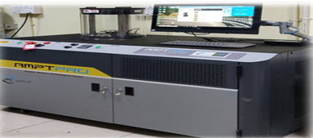
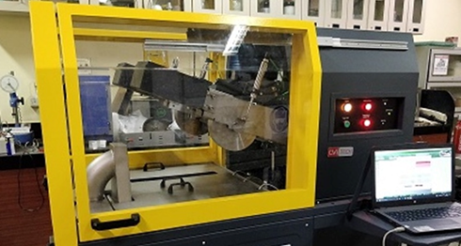



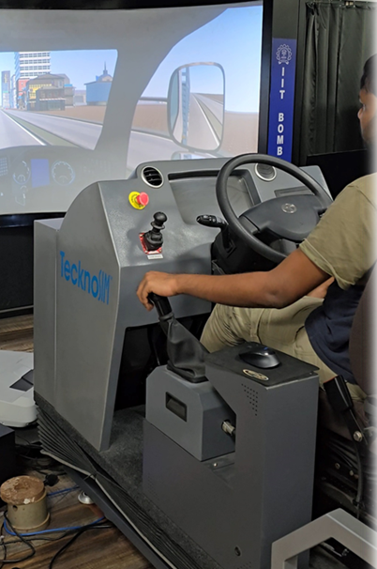
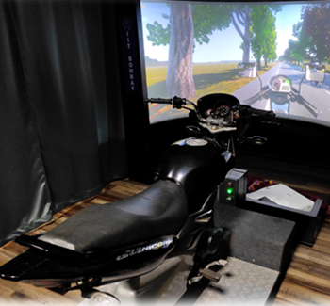



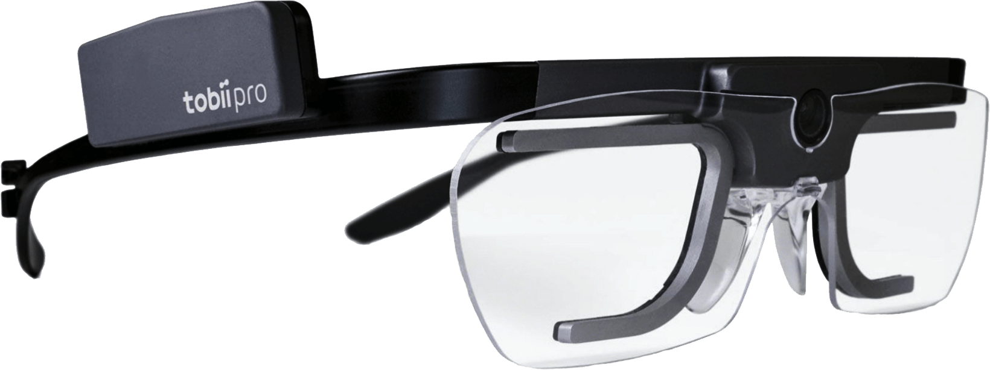
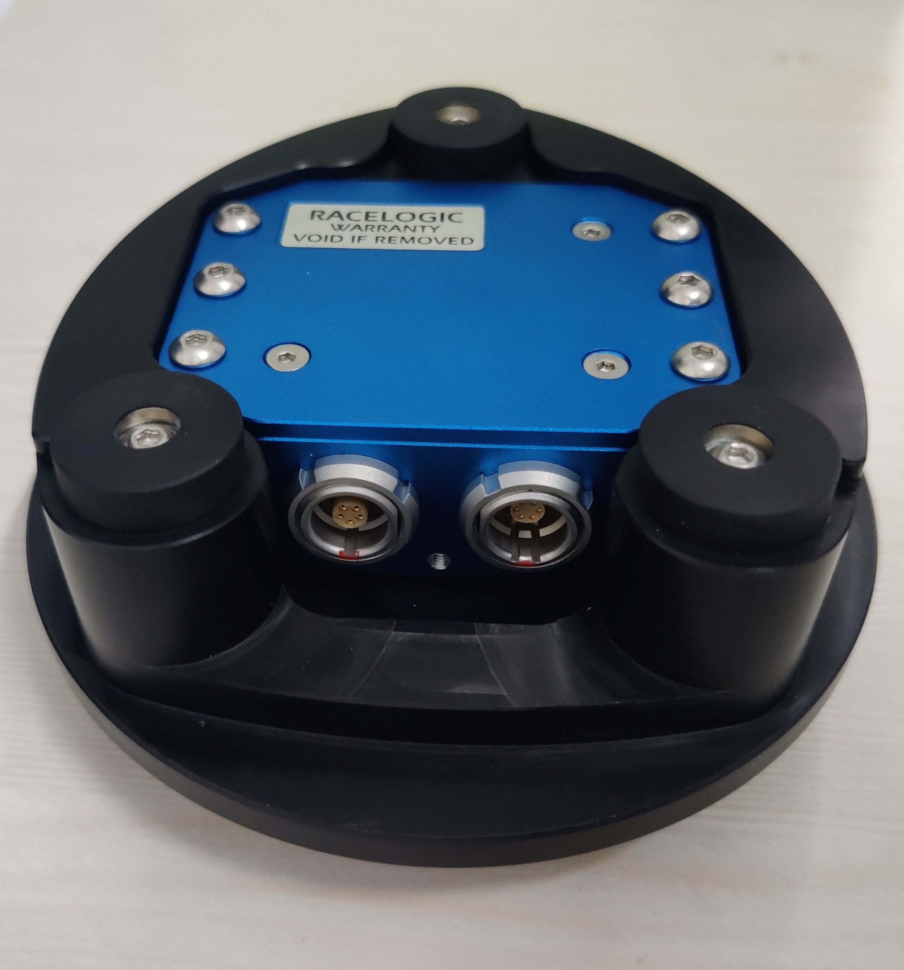
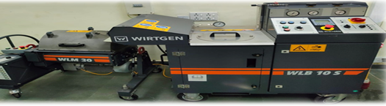

CE1
Transportation Systems Engineering – TSE
Research Infrastructure - TSE Lab Facilities
Specialized Laboratories
Major Equipment/Facilities
Advanced Setup
Advanced Pavement Lab
State-of-the-art equipment for quality control, engineering performance and characterization of bituminous mixes
Promoting sustainable road construction practices
Asphalt Mix Performance Tester
Hamburg Wheel Tracking
Traffic Engineering Lab
India’s only lab with car, truck and bike simulators for driver behavioral studies
Developed driver training modules for Indian road conditions
Integration of monitoring systems and in-vehicle alerts for safety
Truck Simulator
Bike Simulator
Highway Materials Lab
Highway materials characterization
Training of UG and PG students on highway materials testing
Field Data Collection
Instrumented Vehicle
TSE Studio
Provide working space for more than 40 Research Scholars and Project Associates
Computation facility for transportation infrastructure planning, design and operations
Cold Bituminous Mix Recycling

Slide 17


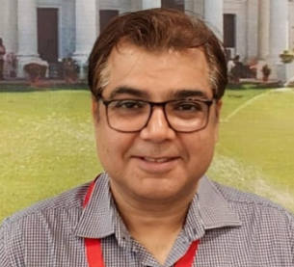
Prof. Ashish Juneja
Geotechnical Engineering
EMAIL
ajuneja@civil.iitb.ac.in

Slide 18
Geotechnical Engineering
(GE) – CE 2

Slide 19
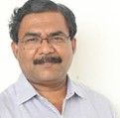
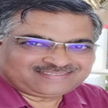
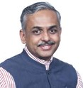
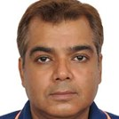
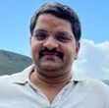
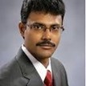
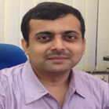
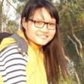
CE2
Geotechnical Engineering – GE
Faculty, Research & Achievements
Faculty Members
8 Members
Research Areas
Prof. D N Singh
Prof. Viswanadham B V S
Sustainable & Environmental Geotechnology
Geotechnical Modelling & Computational Mechanics
Foundations & Underground Infrastructure
Transportation, Offshore & Energy Geotechnics
Geohazards, Risks & Disaster Mitigation
Prof. Deepankar Choudhury
Prof. Ashish Juneja
Group Achievements
National Geotechnical Centrifuge Facility
Large - scale centrifuge facility for advanced soil–structure studies
Prof. Dasaka Murty
Prof. Prasenjit Basu
Standards & Guideline Development
For earthquake geotechnics, dynamic soil behavior & liquefaction studies
Critical Infrastructure projects like “Atal Setu”
Collaborates with industry partners for consultancy & applied research
National & International Collaborations
Joint PhD supervision and research projects
Prof. Santiram Chatterjee
Prof. Pinom Ering
Editorial Leadership & Professional appointments
Editorial Roles in International Journals
Members of Professional Bodies & Committees
Active members of IGS, ISRMTT, IAS, INAE, ASCE etc.

Slide 20
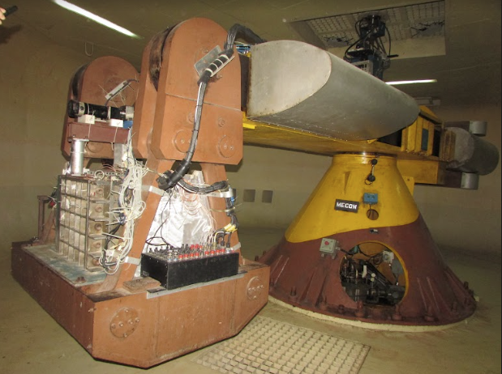
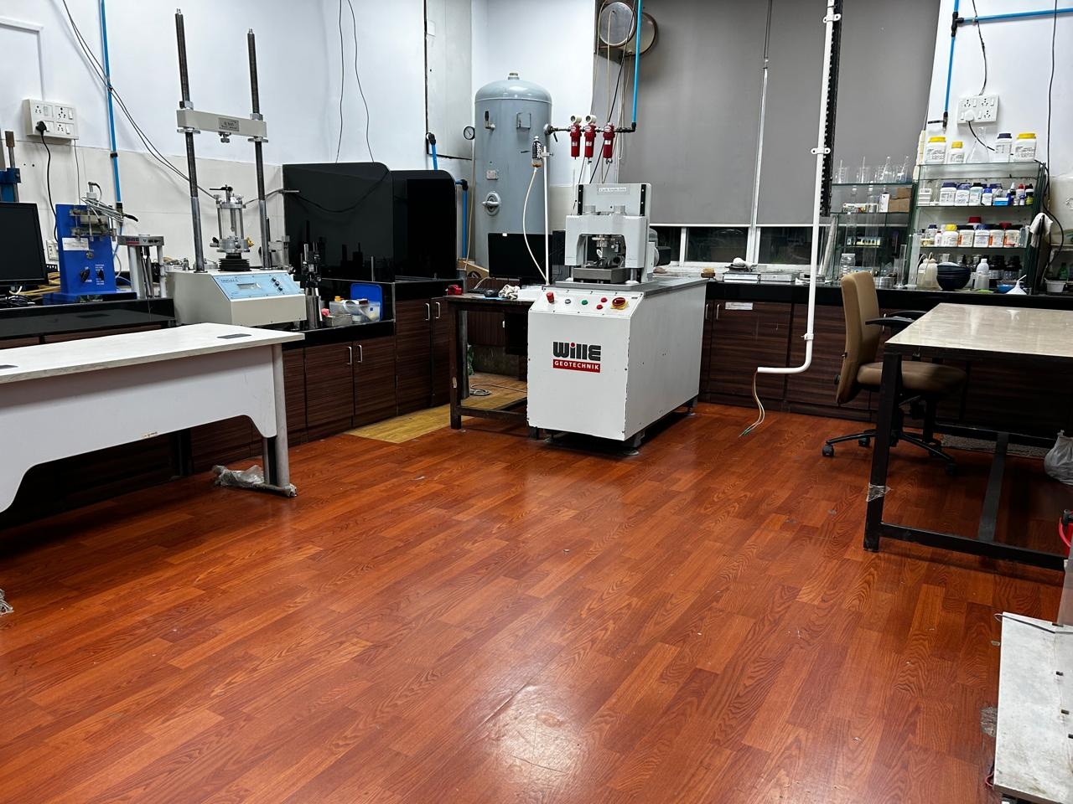

CE2
Geotechnical Engineering – GE
Research Infrastructure - GE Lab Facilities
Specialized Laboratories
Major Equipment/Facilities
Advanced Setup
🌀
National Geotechnical Centrifuge Facility
IIT Bombay's 4.5 m radius large beam centrifuge facility
🏗️
Geotechnical Engineering Laboratory
Testing soil properties for foundation and ground engineering
🌱
Environmental Geotechnology Laboratory
Research on waste reuse and environmental soil engineering.
🧵
Geo-textiles and Geosynthetics Laboratory
IIT Bombay’s 4.5 m radius large beam centrifuge facility
Study of geosynthetics for soil reinforcement and stabilization.
📉
Earthquake Geotechnical Engg. Laboratory
Seismic response analysis and soil dynamics research
🌍
Advance & Dynamic Soil Testing Laboratory
Advanced testing of soil under dynamic and cyclic loads.
⚙️
Advanced Geotechnical Engg. Laboratory
Advanced soil characterization and testing facilities
Advanced & Dynamic Soil Testing laboratory
Advanced Geotechnical Engg. Laboratory

Slide 21

Prof. Bellie Sivakumar
Water Resources Engineering
EMAIL
b.sivakumar@civil.iitb.ac.in

Slide 22
Water Resources Engineering
(WRE) – CE 3

Slide 23












CE3
Water Resources Engineering – WRE
Faculty, Research & Achievements
Faculty Members
10 Members
Research Areas
Prof. Kapil Gupta
Prof. Eldho TI
Hydrology & Water Cycle Processes
Flood Risk, Forecasting & Disaster Mitigation
Hydrological Modelling, AI & Hydro informatics
Water Resources & Watershed Management
Climate Change & Hydroclimatic Extremes
Prof. Jothi Prakash V
Prof. Subimal Ghosh
Prof. Bellie Sivakumar
Prof. Manne Janga Reddy
Group Achievements
Fellowships
Fellows of IASc, INAE, NASI, AGU, AOGS, IE, ISH, IWRS, IAH, IWWA, etc.
Prof. Basudev Biswal
Prof. Riddhi Singh
Publications & Workshops
716+ publications & over 59 workshops conducted recently
Patents
7 patents have been granted
Research recognition
Multiple best paper and thesis awards
Prof. Arpita Mondal
Prof. Anshul Yadav
Editorial Leadership
Editorial Roles in International Journals
Committee Participation
Active in various national level committee's setup by government

Slide 24










CE3
Water Resources Engineering – WRE
Research Infrastructure - WRE Lab Facilities
Specialized Laboratories
Major Equipment/Facilities
Advanced Setup
Fluid Mechanics Laboratory
Hands-on experiments that demonstrate fundamental concepts
Experimental setups: V-notch, Rotameter calibration, subsonic wind tunnel, airfoil drag experiment, streamline visualization, and metacentric height experiment
Hydraulics Laboratory
Modern setups for studying hydraulic machines, open channel flow, groundwater, and hydrology.
Particle Image Velocimetry (PIV)
Ultrasonic flow meter
Turbine and pump test rigs, channel flow models, seepage and rainfall simulators, pipe networks, and water quality testing instruments.
Advanced Experimental Research Laboratory
Advanced instruments such as Particle Image Velocimetry (PIV), Acoustic Doppler Velocimeter (ADV), electromagnetic and ultrasonic flow meters etc.
Open channel Flow meter
Impact of Jet
Workshop Facilities
Fabrication, repair, and maintenance facilities for experimental models and equipment.
Computational Lab
Specialized software such as MIKE, Bentley WaterGEMS and SewerGEMS, ArcGIS, ERDAS, HEC-HMS, HEC-RAS, SWMM, MATLAB, IBM SPSS, Surfer, and Grapher..
Kaplan Turbine
Hydraulics Lab

Slide 25

Prof. Jayadipta Ghosh
Structural Engineering
EMAIL
jghosh@civil.iitb.ac.in

Slide 26
Structural Engineering
(SE) – CE 4

Slide 27




















CE4
Structural Engineering – SE
Faculty, Research & Achievements
Faculty Members
17 Members
Research Areas
Prof. Pradipta Banerji
Prof. Alok Goyal
Prof. Ravi Sinha
Structural Dynamics & Earthquake Engineering
Structural Health Monitoring & Smart Infrastructure
Computational Mechanics & Structural Analysis
Structural Reliability, Risk & Infrastructure Resilience
Advanced Structural Materials & Rehabilitation
Prof. Yogesh Desai
Prof. R.S. Jangid
Prof. Naresh K Chandiramani
Prof. Siddhartha Ghosh
Prof. Sauvik Banerjee
Prof. Mandar Inamdar
Group Achievements
Excellence in Teaching Awards
Multiple faculty received teaching awards throughout their careers
Prof. Swagata Basu
Prof. Arghadeep Laskar
Prof. Jayadipta Ghosh
Standards Development
Development of guidelines, specifications and manuals in structural eng.
Honorary Affiliations
Faculty part of several committees in the domain of structural eng.
Prof. Manish Kumar
Prof. Meera Raghunandan
Prof. Najeeb Shariff Mohammad
Leadership for inter – disclipnary centers
Setup & operations of CCES & CUSE among other centers @ IIT Bombay
Editorial Leadership
Editorial Roles in International Journals
Prof. Tushar Kanti Mandal
Prof. Ashish Pal
Industry & Research Collaboration
Multiple research & consultancy projects completed for industry & govt.

Slide 28





CE4
Structural Engineering – SE
Research Infrastructure - SE Lab Facilities
Specialized Laboratories
Major Equipment/Facilities
Advanced Setup
Heavy Structures Laboratory
Advanced infrastructure for testing large structural elements.
Supports research & experimentation using specialized equipment & testing setups.
Experimental Mechanics Laboratory
🏗️
Studying the mechanical behavior of materials & structural components under loads.
Reaction Frame
Testing of Precast RC Tunnel segment
⚡
Shock and Impact Dynamics Laboratory (SIDL)
Research related to structures and materials under high strain rate loading
Structural Health Monitoring & Retrofitting Laboratory
🔧
Develops and evaluates retrofitting and strengthening methods.
Universal Testing Machine (Instron)
360° Drilling Machine (RM62-HMT)
🧱
Ageing Laboratory
Research on material ageing, performance evaluation to enhance life of civil infrastructure.
🔗
Structural Nano & Bio-Mechanics Laboratory
Interdisciplinary research to develop advanced materials and structural applications.
Single Stage Gas Gun
Shock Tube

Slide 29

Prof. Manasa Ranjan Behera
Ocean Engineering
EMAIL
manasarb@civil.iitb.ac.in

Slide 30
Ocean Engineering
(OE) – CE 5

Slide 31



CE5
Ocean Engineering – OE
Faculty, Research & Achievements
Faculty Members
5 Members
Research Areas
Prof. R. Balaji
Coastal Hydrodynamics & Natural Hazard Modelling
Ocean & Coastal Infrastructure Engineering
Sediment Transport & Coastal Morpho Dynamics
Climate Change Impacts & Coastal Resilience
Computational Ocean Engineering & Wave Dynamics
Director, NIOT (MoES)
Prof. Manas R. Behera
Prof. Srineash V. K.
Group Achievements
Awards
R J Garde Award, IEI Young Engineers Award, Rising star award
Strategic MoUs
Odisha State Disaster Management Authority, Indian Register of Shipping
Prof. Ananth Wuppukondur
Prof. Gowri Shankar C
Key Contributions
7 Development of BIS codes, In-house wave generation system
Patents
Three Patents Granted
Editorial Leadership
Editorial Roles in International Journals
Committee Participation
Active in various national level committee's setup by government

Slide 32
















CE5
Ocean Engineering – OE
Research Infrastructure - OE Lab Facilities
Specialized Laboratories
Major Equipment/Facilities
Advanced Setup
2D Wave Flume
Dimensions: 50m long, 1m wide, 1m deep
Equipped with in-house developed wave maker
Wave-Current Flume (New)
Dimensions: 40m long, 1m wide, 1.25m deep
Advanced facility for combined wave and current studies
IP & Project Impact
Trademark: 6423223-8 | Copyright: 16348/2024-CO/SW
Utilized for Deep Ocean Mission & Pondicherry Beach Restoration
2D Wave Flume
Wave current flume
Instrumentation
Wave Gauges
Pressure Transducers
3D Acoustic Doppler Velocimeter
6DOF Motion Capture
Underwater Load Cell
Echo-Sounder
Current Meter (RCM)
Field Instruments
Ocean Computational Laboratory

Slide 33

Prof. Indu J
Remote Sensing
EMAIL
indusj@civil.iitb.ac.in

Slide 34
Remote Sensing
(RS) – CE 6

Slide 35






CE6
Remote Sensing – RS
Faculty, Research & Achievements
Faculty Members
4 Members
Research Areas
Remote Sensing Technologies & Data Processing
Geospatial Systems & Precision Surveying
Hydrology & Water Resources using Remote Sensing
Atmospheric & Precipitation Monitoring
Climate, Cryosphere & Environmental Monitoring
Prof. Raaj Ramsankaran
Prof. J. Indu
Group Achievements
Awards
National & International Best Paper, Research & Teaching awards
Prof. Eswar Rajasekaran
Prof. Sanchari Thakur
Fellowships
High level visiting fellowship awarded by the French Institute in India
Research Collaborations
Funding by Danish Ministry of Higher Education & Research
Recognition
Invited by NASA SWOT mission to present India centric work on SWOT
Editorial & Committee Leadership
Inducted to group on “Geodetic Reference frame” under NGP
National Geospatial Award 2025
Outstanding contributions to geospatial science and cryosphere studies.

Slide 36













CE6
Remote Sensing – RS
Research Infrastructure - RS Lab Facilities
Specialized Laboratories
Major Equipment/Facilities
Advanced Setup
Engineering Survey Lab
Total Stations (Trimble & Pentax)
Auto Levels
Trimble R12 GNSS Receivers
Trimble R12 GNSS Receivers
DJI Matrice 250 RTK
Photogrammetry Lab
DJI Phantom 4 Pro
Network attached storage
SenseFly eBee Mapping Drone
GNSS Data Processing Workstation
DJI Matrice 250 RTK
Unmanned Surface Vehicle
CORS Station
Advanced Engineering Surveying Laboratory
CORS Station
Handheld GPS Units
DJI Phantom 4 Pro
SenseFly eBee Mapping Drone

Slide 37

Prof. Venkata Santosh Kumar
Construction Technology And Management
EMAIL
venkatad@civil.iitb.ac.in

Slide 38
Construction Technology and Management
(CTAM) – CE 7

Slide 39








CE7
Construction Technology and Management – CTaM
Faculty, Research & Achievements
Faculty Members
7 Members
Research Areas
Prof. Nanthagopalan
Prof. Arnab Jana
Sustainable Construction & Infrastructure Project Management
Advanced Construction Materials & Concrete Technology
Digital Construction & Smart Infrastructure Systems
Infrastructure Planning, Urban Systems & Policy Analytics
Structural Durability & Heritage Conservation
Prof. Venkata Santosh Kumar Delhi
Prof. Muhammad Salman
Group Achievements
International Collaborations
U. Sydney, ETH Zurich, MIT, Teesside etc.
Prof. Albert Thomas
Prof. Swathy Manohar
Prestigious Fellowships
Associate - IAS, DST-BHAVAN, R.S. Subramanian, UNESCO Fellowship
Notable Awards
NSG Counter-IED Innovator Award, Thorpe Medal, Best Paper awards
Innovation
5 Patents have been granted
Prof. Varun Kumar Reja
Editorial Leadership
Editorial Roles in International Journals
Outreach activities
Several workshops & conferences to educate students and professionals

Slide 40







CE7
Construction Technology and Management – CTaM
Research Infrastructure - CTaM Lab Facilities
Specialized Laboratories
Major Equipment/Facilities
Advanced Setup
Construction Materials Laboratory
Particle Size and Shape Analyser (PSSA)
Freeze Dryer
Simultaneous Thermal Analyser
Structural Evaluation and Materials Technologies (SEMT) Lab
3D Printing Facility
Rheometer
Freeze Dryer
Carbonation chamber
Rheometer
Rapid chloride migration test
Construction Management Studio
BIM
Scheduling Software - Primavera
Software in CTM Lab
Carbonation Chamber

Slide 41









Office and Support Staff
Administration
office@civil.iitb.ac.in
Mr. Sashank Bastav
Mr. Paras Lodh
Mr. Sanjay Shivsharan
Mr. Ayush Vikran Singh
Finance
stores@civil.iitb.ac.in
Mr. Aravind Jadhav
Ms. Ekta Warik
Mr. Vijay Dhanve
Computing
Details
www.civil.iitb.ac.in/staff
sysad@civil.iitb.ac.in
Mr. Mandar Joshi
Mr. Vinod Potjale

Slide 42
Major Instructions
Support
  FAQ Page
  Email: office@civil.iitb.ac.in
  Visiting Time - 12:30 – 1:00
            - 5:00 – 6:00
Compliance
  Institute rules
  Department regulations
  Communications vide official emails
Applications
  AMS/Hard Copy
  Through Proper Channel
  Faculty Advisor / Supervisor
  Submit to HoD’s office
  Office to IIT Administration
Adhere to the academic calendar
  Course registration
  Fee payment
  Course work, examinations, and submissions.
Leave
  Leave Management Portal
  Prior Approval Mandatory
  Credentials for login will be shared soon

Slide 43
Document verification for PG and PhD students
Date : 25th July 2026 (Saturday)
Venue: LA 001, Lecture Hall Complex.
Schedule is already shared on your IIT B email ID.
Until your document verification is completed, you are requested to mark your attendance manually at the Department Office starting from today.
Once the document verification process is completed, further instructions regarding the regular Biometric attendance process will be communicated to you.

Slide 44

Venkatesh Vijay Dahale
PG Representative
EMAIL
cea.phd@civil.iitb.ac.in
cea.mtech@civil.iitb.ac.in

Slide 45

Institute Student Companion Program
  ISCP is a student-led mentorship program under the Dean AP Office, designed to help newly admitted postgraduate students transition smoothly into academic and campus life at IIT Bombay through guidance, support, and peer interaction.
  ISCP fosters a supportive and inclusive environment by promoting peer interaction, encouraging open communication, and providing emotional support to help students maintain their mental well-being while adapting to the academic and social life at IIT Bombay.
  ISCP is led by the Overall Coordinator (OC), supported by Associate Coordinators (ACs), who oversee and guide Department Coordinators (DCs) across various departments.

Slide 46


Institute Student Companion Program
Department Coordinators
OMKAR VATHARE
RISHI GANESH L
25m0549@iitb.ac.in |
+91 94235 16451
25m0611@iitb.ac.in |
+91 63694 07600
Department Coordinators manage a team of Student Companions (SCs), who serve as peer mentors and the primary point of contact for newly admitted students, helping them transition smoothly into academics and campus life.

Slide 47
Institute Student Companion Program
Student Companions
  Student Companions are senior student mentors who form the backbone of the Institute Student Companion Programme, ensuring that every new entrant has a reliable peer to guide them.
  They assist freshers with admissions, registration, course selection, hostel life, institute facilities, and navigating academics and campus life.
  Beyond academics, Student Companions foster an approachable, inclusive, and supportive environment, regularly checking in on mentees and promoting their mental health and overall well-being throughout the academic year.

Slide 48










Institute Student Companion Program
Student Companions
RUSHIKESH BHOSALE
25m0541@iitb.ac.in
+91 84214 06348
ADITYA KOURAV
25m0542@iitb.ac.in
+91 7440 877 096
ANMOL TIWARI
25m0545@iitb.ac.in
+91 79054 64070
SRIJANEE CHAKRABORTY
25m0572@iitb.ac.in
+91 93301 14857
PINJARI BABA FAKRUDDIN
25m0573@iitb.ac.in
+91 94410 45987
ABHIJEET BILPE
25m0551@iitb.ac.in
+91 79727 16616
NESAR B ITAGALLI
25m0568@iitb.ac.in
+91 8073 615 853
SARAH MARIA SAJITH
25m0569@iitb.ac.in
+91 884 890 1687
ARYAN DINESH RAMTEKE
25m0579@iitb.ac.in
+91 96373 14812
SARANSH KAR
25m0586@iitb.ac.in
+91 94193 58030

Slide 49











Institute Student Companion Program
Student Companions
JATIN GAWLI
25m0578@iitb.ac.in
+91 95795 94971
SHREYA VS
25m0597@iitb.ac.in
+91 89214 70429
RIDDHI JETHWA
25m0601@iitb.ac.in
+91 87672 34800
SONALI KADAM
25m0602@iitb.ac.in
+91 91584 82815
MINTI JASAKIYA
25m0614@iitb.ac.in
+91 6355 981 500
KRISHNA PACHERIWAL
25m0640@iitb.ac.in
+91 99092 79140
YASHPAL SONI
25m0593@iitb.ac.in
+91 70234 30126
VIOLINA KASHYAP
25m0604@iitb.ac.in
+91 84537 31669
BISHAL BALAYAR
25m0638@iitb.ac.in
+91 82660 73524
ARUNIMA K
25m0608@iitb.ac.in
+91 99951 22004
ONKAR SARJERAO KUMBHAR
25m0571@iitb.ac.in
+91 77448 28963

Slide 50






DEPT NAME
Department Name
Department Orientation
1

Slide 51





PG-CAMP
PGAC, ISCP and IRSCP
Post Graduate Academic Council
Institute Student Companion Programme
Institute Research Scholar Companion Programme
2

Slide 52


3

Slide 53

Anshu
General Secretary Academic Affairs
gsecaapg@iitb.ac.in
4

Slide 54



Amruta Iyer
Harsh Srivastava
Vishnu T.S.
Institute Secretary Academic Affairs (Doctoral)
Institute Secretary Academic Affairs (Masters)
Institute Secretary International Relations
idr@iitb.ac.in
imr@iitb.ac.in
isecir@iitb.ac.in
5

Slide 55

6

Slide 56

7

Slide 57



Know your
Representatives
DEPARTMENT COORDINATORS
OMKAR VATHARE
RISHI GANESH L
25m0549@iitb.ac.in |
+91 94235 16451
25m0611@iitb.ac.in |
+91 63694 07600
Department Coordinators manage a team of Student Companions (SCs), who serve as peer mentors and the primary point of contact for newly admitted students, helping them transition smoothly into academics and campus life.
8

Slide 58










Know your
Representatives
STUDENT COMPANIONS
RUSHIKESH BHOSALE
25m0541@iitb.ac.in
+91 84214 06348
ADITYA KOURAV
25m0542@iitb.ac.in
+91 7440 877 096
ANMOL TIWARI
25m0545@iitb.ac.in
+91 79054 64070
SRIJANEE CHAKRABORTY
25m0572@iitb.ac.in
+91 93301 14857
PINJARI BABA FAKRUDDIN
25m0573@iitb.ac.in
+91 94410 45987
NESAR B ITAGALLI
25m0568@iitb.ac.in
+91 8073 615 853
SARAH MARIA SAJITH
25m0569@iitb.ac.in
+91 884 890 1687
ARYAN DINESH RAMTEKE
25m0579@iitb.ac.in
+91 96373 14812
SARANSH KAR
25m0586@iitb.ac.in
+91 94193 58030
8
ABHIJEET BILPE
25m0551@iitb.ac.in
+91 79727 16616

Slide 59











Know your
Representatives
STUDENT COMPANIONS
JATIN GAWLI
25m0578@iitb.ac.in
+91 95795 94971
SHREYA VS
25m0597@iitb.ac.in
+91 89214 70429
RIDDHI JETHWA
25m0601@iitb.ac.in
+91 87672 34800
SONALI KADAM
25m0602@iitb.ac.in
+91 91584 82815
MINTI JASAKIYA
25m0614@iitb.ac.in
+91 6355 981 500
KRISHNA PACHERIWAL
25m0640@iitb.ac.in
+91 99092 79140
YASHPAL SONI
25m0593@iitb.ac.in
+91 70234 30126
VIOLINA KASHYAP
25m0604@iitb.ac.in
+91 84537 31669
BISHAL BALAYAR
25m0638@iitb.ac.in
+91 82660 73524
ARUNIMA K
25m0608@iitb.ac.in
+91 99951 22004
ONKAR SARJERAO KUMBHAR
25m0571@iitb.ac.in
+91 77448 28963
8

Slide 60


Course
Registration
    Course registration mandatory every semester
    No registration for 2 consecutive semesters ➔ ADMISSION CANCELLED
    Adjust courses STRICTLY within the deadline
    Academic Calendar for all the activities and deadlines
9

Slide 61

All About
Courses
10

Slide 62


Grading
SPI/CPI (Semester/Cumulative)
Credited Weighted Average Grade
Minimum Grade Requirements
CPI < 4
Academic Probation/ Stipend Reduction
>= 2 FR in one semester
Discontinuation of the Programme
11

Slide 63

Academic
Malpractices
13

Slide 64

International Opportunities
    Program-specific MoUs signed with Top Universities around the world.
    Access to some of the top research labs around the world.
    Network with esteemed professors and peer groups around the globe.
    Semester exchange program for Master’s students.
    Research Collaborations with various universities offer a great opportunity for PhD students
14

Slide 65
How Will
PGAC Help?
    A dedicated team of mentors headed by ISIR(PG)
    Assistance in identifying suitable exchange programs and courses
    Support during application and pre-departure process
    Interactive sessions with previously enrolled students
    Mentorship support will remain active throughout the exchange program
15

Slide 66





Important Links
ASC Internal
Academic
Calender
ASC External
Rule Books
IR Office
Grievance Portal
16

Slide 67


Follow Us
Website
17

Slide 68
Follow Us
Grivance Portal
18

Slide 69


Follow Us
Instagram
19

Slide 70
Course
Registration
Date: July 23, 2026
Time: 3 PM to 5 PM
Venue: Classroom 212, 228, 233 – Department of Civil Engineering
20

Slide 71
THANK YOU
Let's Create Something Amazing Together
21

Slide 72


















MEET YOUR COUNCIL
DEPARTMENT GENERAL SECRETARY
The Department General Secretary is responsible for representing the student body, addressing their concerns, and ensuring the smooth execution of departmental activities.
Gursheel Singh

Slide 73
MEET YOUR COUNCIL
PG REPRESENTATIVE
The PG Representative serves as the primary point of contact for postgraduate students, representing their academic and student welfare concerns, facilitating communication with the department, and ensuring active participation in departmental initiatives and activities
Venkatesh Vijay Dahale

Slide 74



MEET YOUR COUNCIL
Sarthak Kastiya
Vedant Patel
Stuti Agrawal
Joint Secretary Academic Affairs
Joint Secretary Events
Chief Editor

Slide 75







MEET YOUR COUNCIL
Chirag kejriwal
Karan Pilania
Bhavya
Pranav Malik
Associate Sec.
Associate Sec.
Design & Media Sec.
Design & Media Sec.
Jasmeen Patel
Yashvi Shah
Nandita Chandrawat
Design & Media Sec.
Editor
Editor

Slide 76




MEET YOUR COUNCIL
Aditya Aryan Choubey
Divit Ghorpade
Aditya Kiran Parasa
Akshita Baid
Sports Sec.
Marketing Sec.
Web Sec.
Alumni Sec.

Slide 77

Building Resilience Through Engineering

Slide 78

EERI AT A GLANCE
    EERI, established in 1948, connects professionals worldwide to advance earthquake risk reduction, with student chapters in top universities.
    The chapter provides a platform for students to gain practical experience, understand earthquake impacts, and explore careers in earthquake engineering and related fields.
    IIT Bombay established its student chapter in 2021.

Slide 79






SEISMIC DESIGN COMPETITION
    Organized by EERI every year for undergraduate students
    Participants construct a cost-effective and sustainable building model to resist seismic loading
    Participation from more than 50 universities of top QS ranking across the globe
COMPETITION OBJECTIVE : PROMOTE EARTHQUAKE ENGINEERING THROUGH HANDS-ON SEISMIC DESIGN PROJECTS AND EERI ENGAGEMENT.
STRONGER STRUCTURES, SAFER LIVES

Slide 80


Building Phase
Final scrutineering

Slide 81
EERI IITB THROUGH THE YEARS AT SDC
SDC 2021 (Virtual) : Won the Charles Richter Award for the Spirit of the Competition
SDC 2022 : Secured the 16th overall position.
SDC 2023 : Achieved its best-ever 8th position overall
SDC 2024 : Encountered structural failures but ranked 3rd among
collapsed structures
SDC 2025 : Secured the 15th overall position, with top-15 ranks in Communication, Financial Modelling, and Architecture
SDC 2026 : Secured the 11th overall position and Won the Egor Popov Award for Structural Innovation

Slide 82



EERI IIT Bombay STUDENT CHAPTER
at SDC 2026
Portland, Oregon, USA

Slide 83
FIND YOUR PLACE AT EERI IITB STUDENT CHAPTER
Discover the subdivision that matches your interests.
Structural & Construction
    Design structures using ETABS
    Laser-cut & assemble balsa wood models
    Build, test & refine your designs
Geotech
    Analyze soil & foundations
    Study seismic hazards
    Apply geotechnical concepts
Dampers
    Explore vibration control
    Design & test dampers
    Improve structural resilience
Architectural
    Design using AutoCAD & 3ds Max
    Create functional layouts
    Integrate architecture & engineering
Business
    Secure sponsorships
    Organize events & outreach
    Lead branding & communications

Slide 84


STAY CONNECTED!
Don't miss recruitment updates
Scan to stay updated!

Slide 85
THANK YOU!

Slide 86



Team SHUNYA
WELCOMES YOU TO
IIT BOMBAY!!
PAGE 1

Slide 87



Slide 88


Slide 89



S
ustainable
Vision
H
abitats for
“To become a leading innovation hub in the field of sustainability by providing accessible housing solutions for society and industry.”
U
rbanizing
Our Mission
N
To bring a change in the Indian building industry, by demonstrating the affordability of sustainable housing, to formulate and document a design process, which could be replicated to create sustainable homes in a resource efficient way and to raise awareness in the nation about energy efficiency, responsible energy use and the potential of renewable technology with emphasis on solar energy.
ation by its
Y
oung
A
spirants

Slide 90








PAST PROJECTS
Project H-naught
Solar Decathlon Europe, 2014
Project Daksh
SAMSARA
2024
CoDe VAYU
US Solar Decathlon,
2021
Solar Decathlon India,
2025
Project Solarize
Project Vivaan
Solar Decathlon China, 2018
US Solar Decathlon, 2023
Project SEVA
US Solar Decathlon, 2025

Slide 92



Current Projects
Sheetansh
Nivas EcoTech
Digital Twin
A compact personalized cooling dome uses chilled-water circulation and ESP32-based dew-point control to deliver efﬁcient, condensation-free localized cooling.
An AI-powered tool that delivers climate-responsive green building designs using a hybrid multi-agent system with automated analysis and reporting.
A hybrid digital twin system integrates sensing, data-driven modeling, and intelligent control to enable real-time, adaptive, and efﬁcient indoor environment management.
PAGE 18

Slide 93

















Team Structure
45 + 16 +
Students from all Courses
75 +
5
Industry Collaborations
Faculty Advisors from 3 departments
Departments and Schools
Professors
Industry Partners
›
10+Research students with
Industrial Work Experience Students from Architecture,
Engineering, Management
Subsystems
›
250 +
Alumni Team Members
Architectural
Energy & Automation
Core Team Integration
›
Industry Professional (in US, Japan, Germany)
Academia (in NUS, IIT Delhi, Michigan)
SD India (Technical Research Group –2022)
Civil
Mechanical
Team
Sub-Syste ms
› ›
Business and Communication
Student Team
Alumni
PAGE 4

Slide 94



