Slide 1




Indian Institute of Technology Bombay
Department of
Civil Engineering
Excellence in Education and Research since 1958

Slide 2





Introduction & Overview
Department Profile
Current Enrollment
Key Highlights
Total: ~1103
PM Research Fellows
40
ESTABLISHMENT
1958
Postdoctoral Fellows
30
657
B.Tech
174
M.Tech
272
Ph.D
FACULTY MEMBERS
Foreign Students
31 M.Tech / 5 Ph.D
60 Regular + 4 Visiting
IITB Monash PhD
~15 Students
SUPPORT STAFF
28 Admin/Technical
Graduates Statistics (2019-2025)
Showing gender-wise breakdown
PROGRAMS
PROGRAM | GENDER | 2019 | 2020 | 2021 | 2022 | 2023 | 2024 | 2025 | TOTAL
M. Tech | Male | 59 | 99 | 90 | 69 | 89 | 44 | 66 | 516
 | Female | 18 | 5 | 11 | 9 | 12 | 9 | 11 | 75
Ph.D | Male | 28 | 26 | 33 | 39 | 37 | 31 | 25 | 163
 | Female | 14 | 15 | 16 | 13 | 19 | 12 | 16 | 77
B.Tech in Civil Engg.
7 MTech Specializations
Evolved from Civil Engg.
Environmental Science & Engg
Earth Sciences
Centre for Climate Studies
2

Slide 3









Publication Details & Rankings
Total Papers
Citations of Publications
1,364
Consistent growth in research impact
SCI Journals (2016-2025)
Total: 2270
Last 5 Years
QS World Ranking
Ranked 42 Globally
Civil & Structural
Patents (5 Years)
Applied / Filed
20
Source: Dept. Review Report (2023)
Granted
18
Impact Factor
Consistently increasing citation counts indicate growing global influence of departmental research.

Slide 4

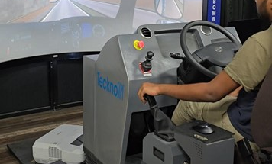
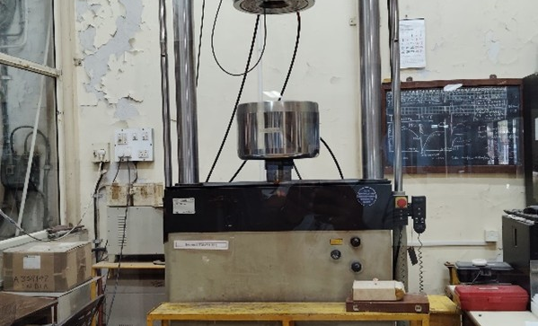
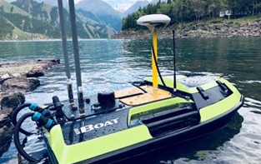
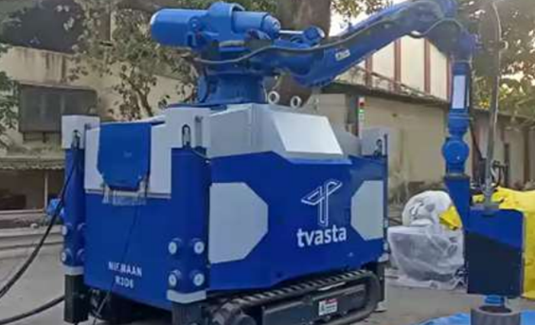
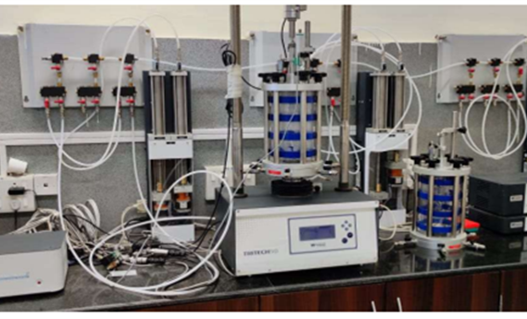





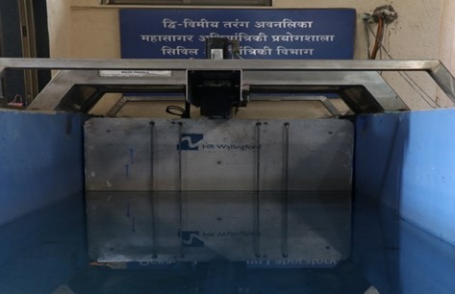
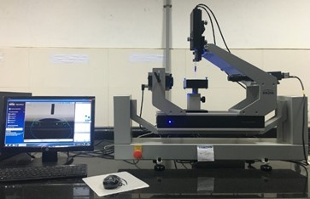
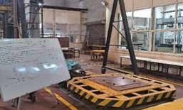
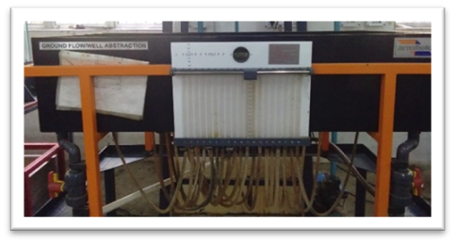
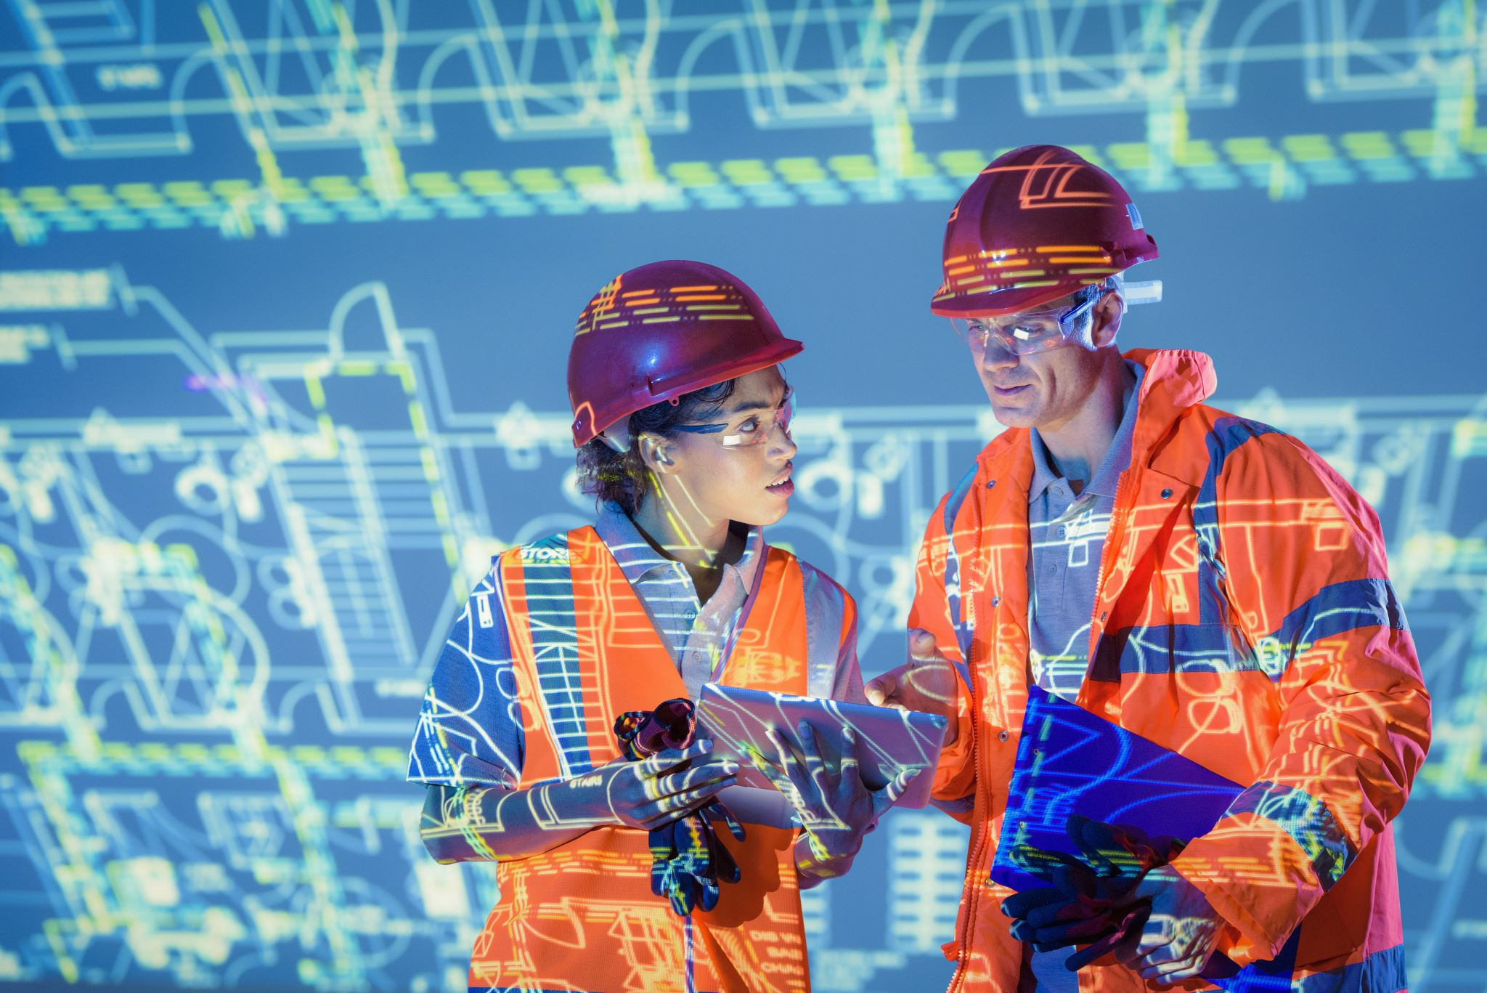




Infrastructure & Capabilities: Major Equipment
Investment Summary (Last 5 Years)
21
₹ 24.31 Crore
Continuous upgradation of research infrastructure
Instruments >20 Lakhs
Total Investment Cost
Driving Simulator
Universal Testing Machine
Unmanned Boat
3D Printer
Triaxial System
2D Wave Maker
Drop Shape Analyser
Shake Table
Ground Water Flow
Future Expansion

Slide 5





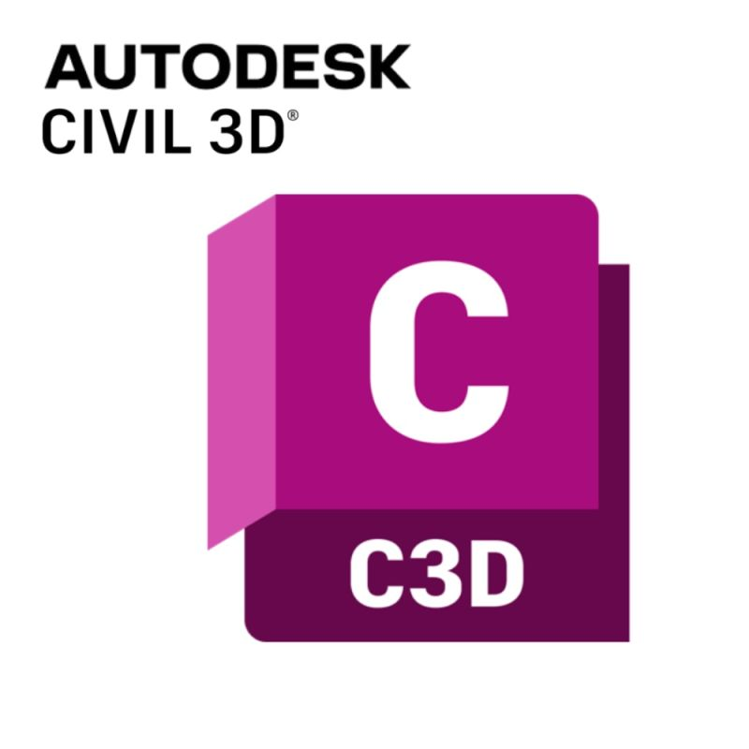
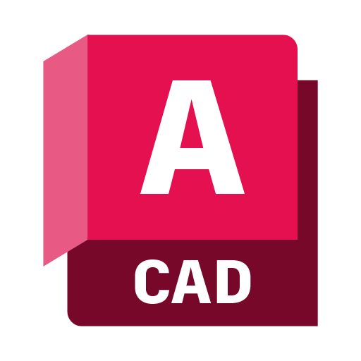


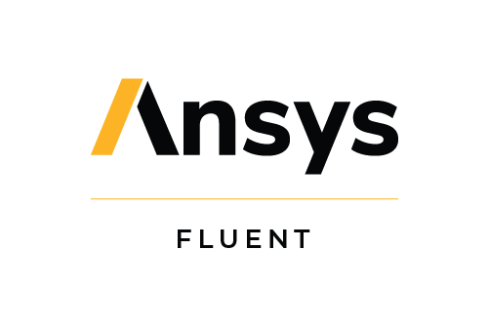











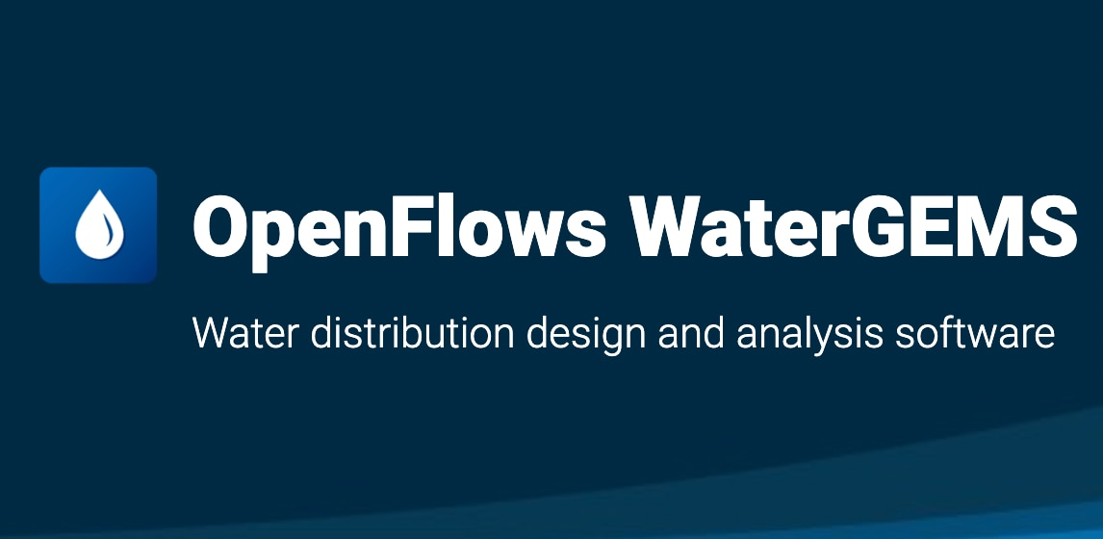
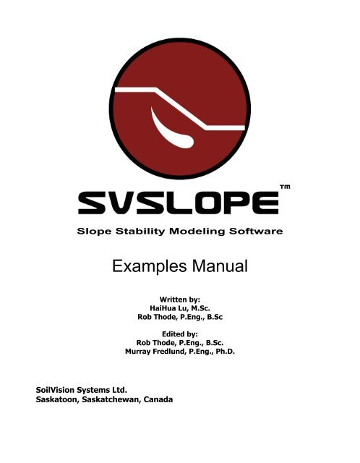













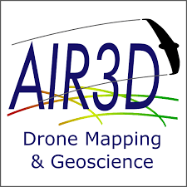





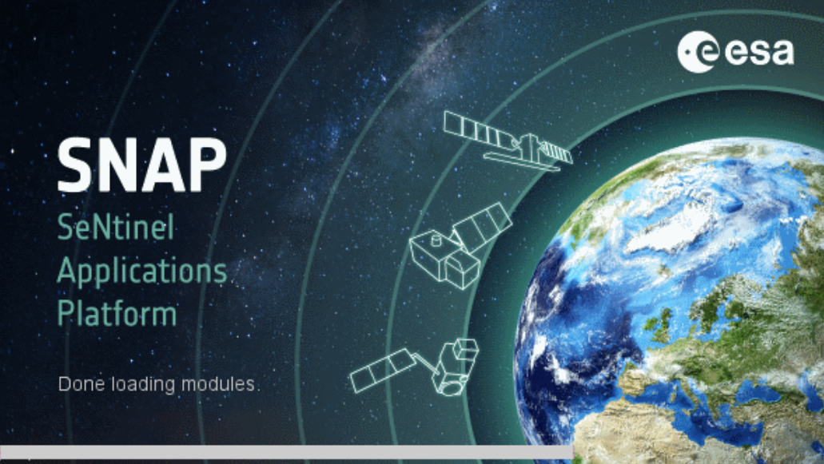



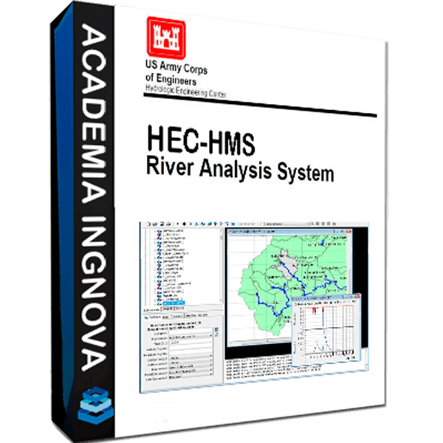

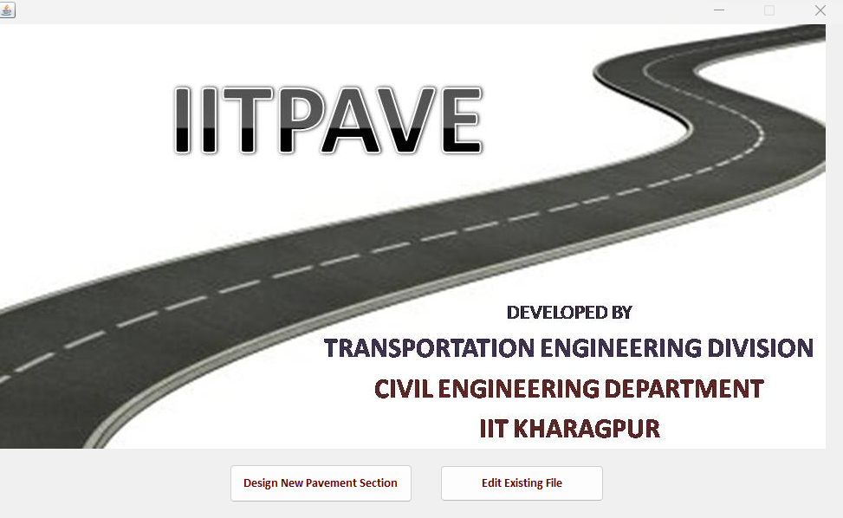






Software Capabilities

Slide 6




























Academic Research Partnerships & Collaborations

Slide 7











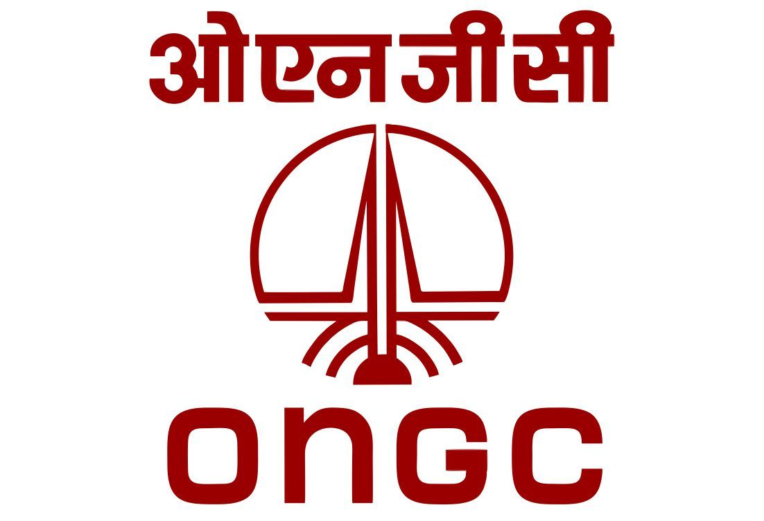





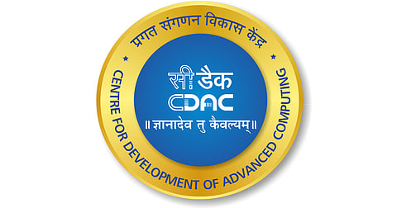































Industry Partnerships & Collaborations

Slide 8
Key Initiatives
Integrated Design Project
Credit Based Industry Internship
Alumni Engagement
Curriculum Review
Outreach Programs

Slide 9





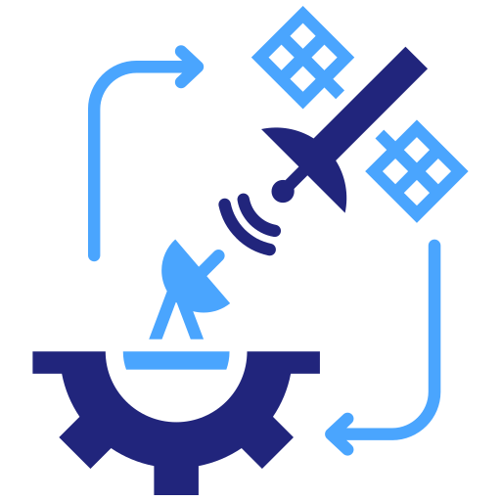

Group specializations
Transportation Systems Engineering
Geotechnical Engineering
Water Resources Engineering
Structural Engineering
Ocean Engineering
Remote Sensing
Construction Technology And Management
www.civil.iitb.ac.in/faculty

Slide 10
Transportation Systems Engineering
(TSE) – CE 1

Slide 11


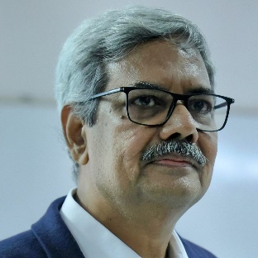
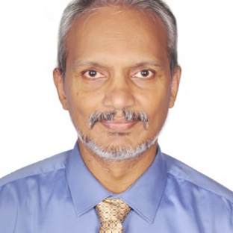
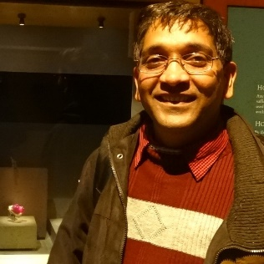
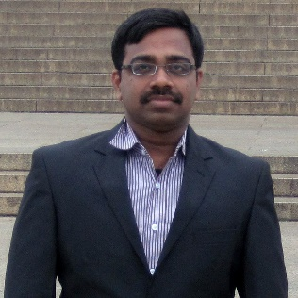
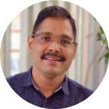
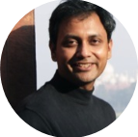


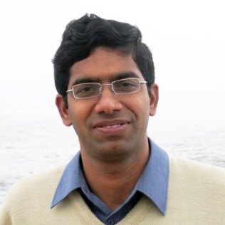
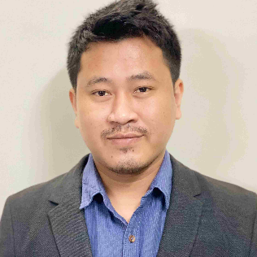



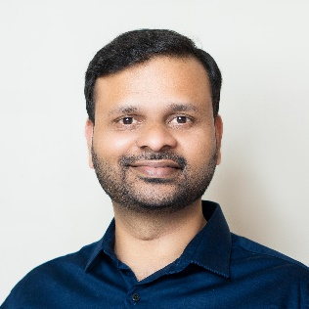
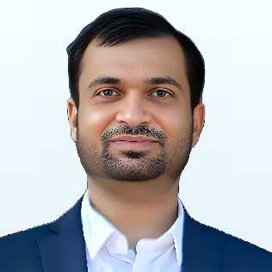

CE1
Transportation Systems Engineering – TSE
Faculty, Research & Achievements
Faculty Members
10 Members
Research Areas
Prof. K V Krishna Rao
Prof. Tom V. Mathew
Transportation Planning & Travel Behavior
Transportation Flow Theory, Operations & Management
Public Transport & Freight Systems
Intelligent & Smart Transportation Systems
Transportation Infrastructure & Pavement Engineering
Prof. Gopal R Patil
Prof. Vedagiri Perumal
Prof. Dharamveer Singh
Prof. Avijit Maji
Group Achievements
State & National Projects
Active participation in significant infrastructure projects
Prof. Nagendra Rao Velaga
Prof. Solomon Debbarma
Standards Development
Involved in guidelines, specifications and manuals development
Indo Highway Capacity Manual
Successfully developed for Indian road conditions
TPMDC Conference
Organizing biennial conference since 1996
Prof. Sangram Nirmale
Prof. Archak Mittal
Editorial Leadership
Editorial Roles in International Journals
Committee Participation
Active in IRC, MoRTH, NCHRP, TRB committees

Slide 12



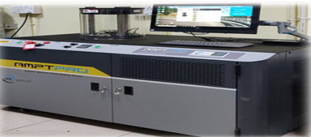
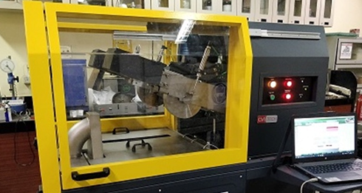



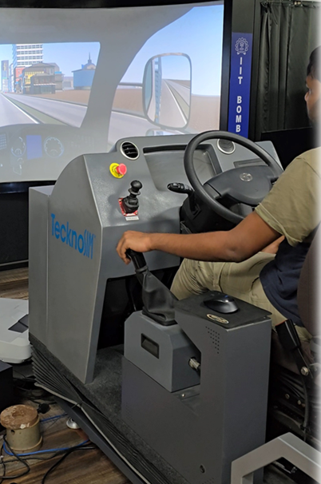
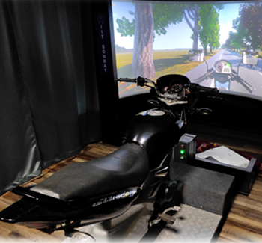


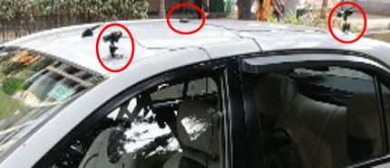

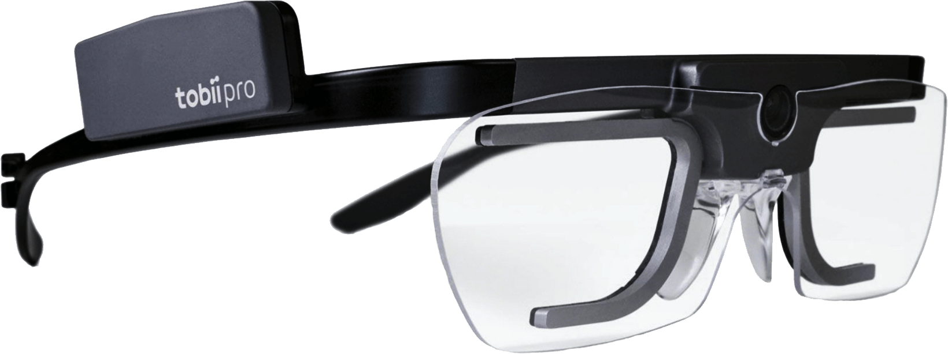
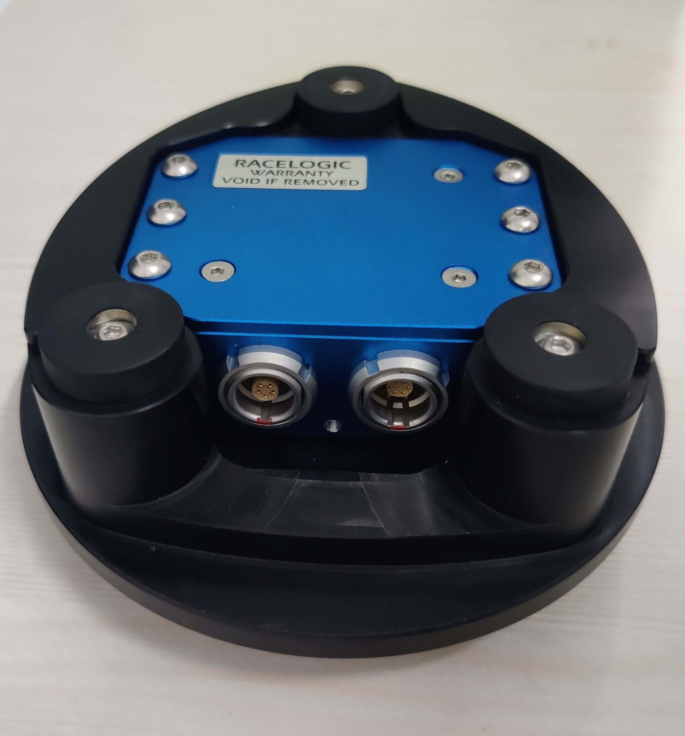
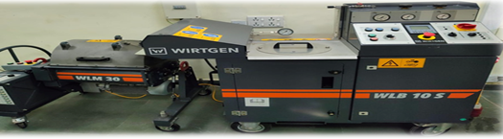


CE1
Transportation Systems Engineering – TSE
Research Infrastructure - TSE Lab Facilities
Specialized Laboratories
Major Equipment/Facilities
Advanced Setup
Advanced Pavement Lab
State-of-the-art equipment for quality control, engineering performance and characterization of bituminous mixes
Promoting sustainable road construction practices
Asphalt Mix Performance Tester
Hamburg Wheel Tracking
Traffic Engineering Lab
India’s only lab with car, truck and bike simulators for driver behavioral studies
Developed driver training modules for Indian road conditions
Integration of monitoring systems and in-vehicle alerts for safety
Truck Simulator
Bike Simulator
Highway Materials Lab
Highway materials characterization
Training of UG and PG students on highway materials testing
Field Data Collection
Instrumented Vehicle
TSE Studio
Provide working space for more than 40 Research Scholars and Project Associates
Computation facility for transportation infrastructure planning, design and operations
Cold Bituminous Mix Recycling

Slide 13
Geotechnical Engineering
(GE) – CE 2

Slide 14
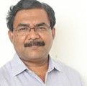
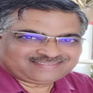
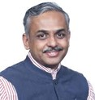
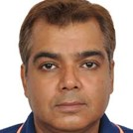
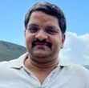
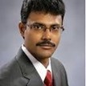
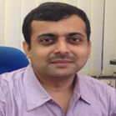
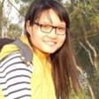
CE2
Geotechnical Engineering – GE
Faculty, Research & Achievements
Faculty Members
8 Members
Research Areas
Prof. D N Singh
Prof. Viswanadham B V S
Sustainable & Environmental Geotechnology
Geotechnical Modelling & Computational Mechanics
Foundations & Underground Infrastructure
Transportation, Offshore & Energy Geotechnics
Geohazards, Risks & Disaster Mitigation
Prof. Deepankar Choudhury
Prof. Ashish Juneja
Group Achievements
National Geotechnical Centrifuge Facility
Large - scale centrifuge facility for advanced soil–structure studies
Prof. Dasaka Murty
Prof. Prasenjit Basu
Standards & Guideline Development
For earthquake geotechnics, dynamic soil behavior & liquefaction studies
Critical Infrastructure projects like “Atal Setu”
Collaborates with industry partners for consultancy & applied research
National & International Collaborations
Joint PhD supervision and research projects
Prof. Santiram Chatterjee
Prof. Pinom Ering
Editorial Leadership & Professional appointments
Editorial Roles in International Journals
Members of Professional Bodies & Committees
Active members of IGS, ISRMTT, IAS, INAE, ASCE etc.

Slide 15
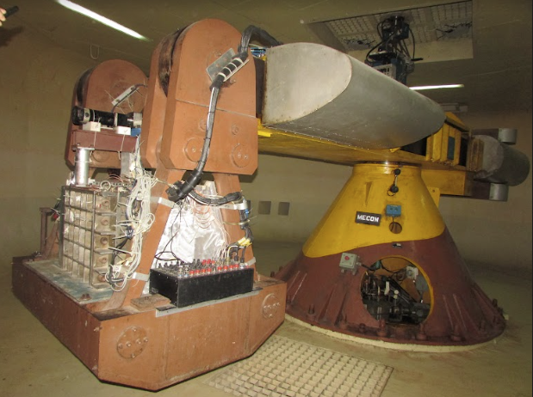
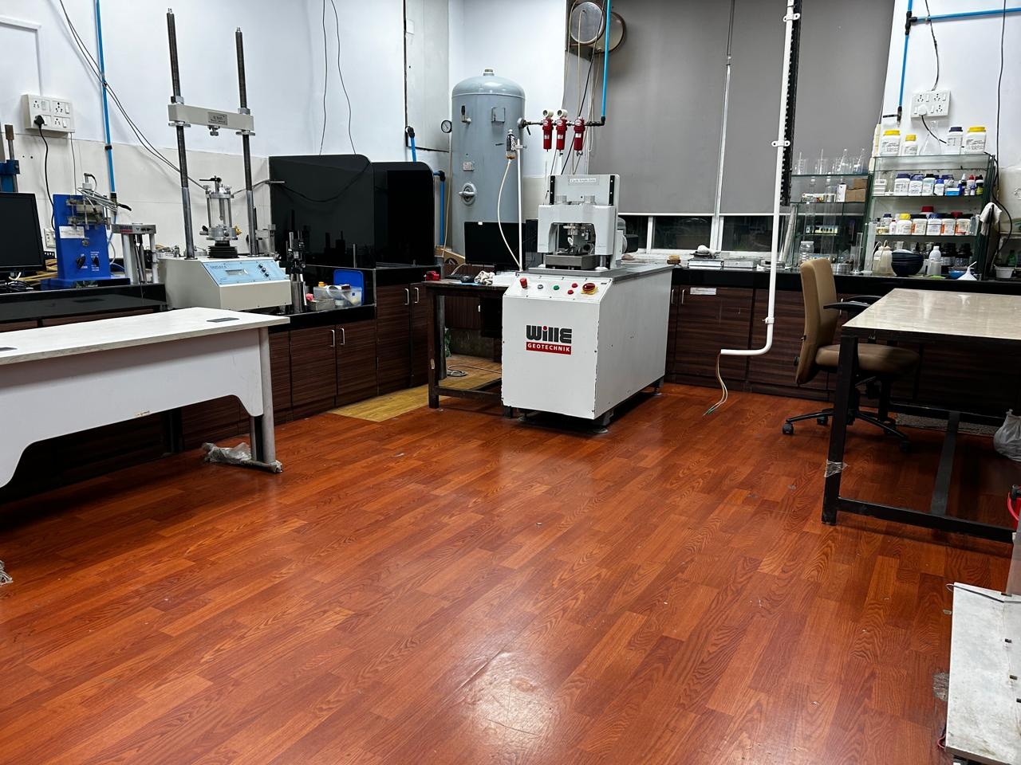

CE2
Geotechnical Engineering – GE
Research Infrastructure - GE Lab Facilities
Specialized Laboratories
Major Equipment/Facilities
Advanced Setup
🌀
National Geotechnical Centrifuge Facility
IIT Bombay's 4.5 m radius large beam centrifuge facility
🏗️
Geotechnical Engineering Laboratory
Testing soil properties for foundation and ground engineering
🌱
Environmental Geotechnology Laboratory
Research on waste reuse and environmental soil engineering.
🧵
Geo-textiles and Geosynthetics Laboratory
IIT Bombay’s 4.5 m radius large beam centrifuge facility
Study of geosynthetics for soil reinforcement and stabilization.
📉
Earthquake Geotechnical Engg. Laboratory
Seismic response analysis and soil dynamics research
🌍
Advance & Dynamic Soil Testing Laboratory
Advanced testing of soil under dynamic and cyclic loads.
⚙️
Advanced Geotechnical Engg. Laboratory
Advanced soil characterization and testing facilities
Advanced & Dynamic Soil Testing laboratory
Advanced Geotechnical Engg. Laboratory

Slide 16
Water Resources Engineering
(WRE) – CE 3

Slide 17












CE3
Water Resources Engineering – WRE
Faculty, Research & Achievements
Faculty Members
10 Members
Research Areas
Prof. Kapil Gupta
Prof. Eldho TI
Hydrology & Water Cycle Processes
Flood Risk, Forecasting & Disaster Mitigation
Hydrological Modelling, AI & Hydro informatics
Water Resources & Watershed Management
Climate Change & Hydroclimatic Extremes
Prof. Jothi Prakash V
Prof. Subimal Ghosh
Prof. Bellie Sivakumar
Prof. Manne Janga Reddy
Group Achievements
Fellowships
Fellows of IASc, INAE, NASI, AGU, AOGS, IE, ISH, IWRS, IAH, IWWA, etc.
Prof. Basudev Biswal
Prof. Riddhi Singh
Publications & Workshops
716+ publications & over 59 workshops conducted recently
Patents
7 patents have been granted
Research recognition
Multiple best paper and thesis awards
Prof. Arpita Mondal
Prof. Anshul Yadav
Editorial Leadership
Editorial Roles in International Journals
Committee Participation
Active in various national level committee's setup by government

Slide 18










CE3
Water Resources Engineering – WRE
Research Infrastructure - WRE Lab Facilities
Specialized Laboratories
Major Equipment/Facilities
Advanced Setup
Fluid Mechanics Laboratory
Hands-on experiments that demonstrate fundamental concepts
Experimental setups: V-notch, Rotameter calibration, subsonic wind tunnel, airfoil drag experiment, streamline visualization, and metacentric height experiment
Hydraulics Laboratory
Modern setups for studying hydraulic machines, open channel flow, groundwater, and hydrology.
Particle Image Velocimetry (PIV)
Ultrasonic flow meter
Turbine and pump test rigs, channel flow models, seepage and rainfall simulators, pipe networks, and water quality testing instruments.
Advanced Experimental Research Laboratory
Advanced instruments such as Particle Image Velocimetry (PIV), Acoustic Doppler Velocimeter (ADV), electromagnetic and ultrasonic flow meters etc.
Open channel Flow meter
Impact of Jet
Workshop Facilities
Fabrication, repair, and maintenance facilities for experimental models and equipment.
Computational Lab
Specialized software such as MIKE, Bentley WaterGEMS and SewerGEMS, ArcGIS, ERDAS, HEC-HMS, HEC-RAS, SWMM, MATLAB, IBM SPSS, Surfer, and Grapher..
Kaplan Turbine
Hydraulics Lab

Slide 19
Structural Engineering
(SE) – CE 4

Slide 20




















CE4
Structural Engineering – SE
Faculty, Research & Achievements
Faculty Members
17 Members
Research Areas
Prof. Pradipta Banerji
Prof. Alok Goyal
Prof. Ravi Sinha
Structural Dynamics & Earthquake Engineering
Structural Health Monitoring & Smart Infrastructure
Computational Mechanics & Structural Analysis
Structural Reliability, Risk & Infrastructure Resilience
Advanced Structural Materials & Rehabilitation
Prof. Yogesh Desai
Prof. R.S. Jangid
Prof. Naresh K Chandiramani
Prof. Siddhartha Ghosh
Prof. Sauvik Banerjee
Prof. Mandar Inamdar
Group Achievements
Excellence in Teaching Awards
Multiple faculty received teaching awards throughout their careers
Prof. Swagata Basu
Prof. Arghadeep Laskar
Prof. Jayadipta Ghosh
Standards Development
Development of guidelines, specifications and manuals in structural eng.
Honorary Affiliations
Faculty part of several committees in the domain of structural eng.
Prof. Manish Kumar
Prof. Meera Raghunandan
Prof. Najeeb Shariff Mohammad
Leadership for inter – disclipnary centers
Setup & operations of CCES & CUSE among other centers @ IIT Bombay
Editorial Leadership
Editorial Roles in International Journals
Prof. Tushar Kanti Mandal
Prof. Ashish Pal
Industry & Research Collaboration
Multiple research & consultancy projects completed for industry & govt.

Slide 21





CE4
Structural Engineering – SE
Research Infrastructure - SE Lab Facilities
Specialized Laboratories
Major Equipment/Facilities
Advanced Setup
Heavy Structures Laboratory
Advanced infrastructure for testing large structural elements.
Supports research & experimentation using specialized equipment & testing setups.
Experimental Mechanics Laboratory
🏗️
Studying the mechanical behavior of materials & structural components under loads.
Reaction Frame
Testing of Precast RC Tunnel segment
⚡
Shock and Impact Dynamics Laboratory (SIDL)
Research related to structures and materials under high strain rate loading
Structural Health Monitoring & Retrofitting Laboratory
🔧
Develops and evaluates retrofitting and strengthening methods.
Universal Testing Machine (Instron)
360° Drilling Machine (RM62-HMT)
🧱
Ageing Laboratory
Research on material ageing, performance evaluation to enhance life of civil infrastructure.
🔗
Structural Nano & Bio-Mechanics Laboratory
Interdisciplinary research to develop advanced materials and structural applications.
Single Stage Gas Gun
Shock Tube

Slide 22
Ocean Engineering
(OE) – CE 5

Slide 23





CE5
Ocean Engineering – OE
Faculty, Research & Achievements
Faculty Members
5 Members
Research Areas
Prof. R. Balaji
Coastal Hydrodynamics & Natural Hazard Modelling
Ocean & Coastal Infrastructure Engineering
Sediment Transport & Coastal Morpho Dynamics
Climate Change Impacts & Coastal Resilience
Computational Ocean Engineering & Wave Dynamics
Director, NIOT (MoES)
Prof. Manas R. Behera
Prof. Srineash V. K.
Group Achievements
Awards
R J Garde Award, IEI Young Engineers Award, Rising star award
Strategic MoUs
Odisha State Disaster Management Authority, Indian Register of Shipping
Prof. Ananth Wuppukondur
Prof. Gowri Shankar C
Key Contributions
7 Development of BIS codes, In-house wave generation system
Patents
Three Patents Granted
Editorial Leadership
Editorial Roles in International Journals
Committee Participation
Active in various national level committee's setup by government

Slide 24
















CE5
Ocean Engineering – OE
Research Infrastructure - OE Lab Facilities
Specialized Laboratories
Major Equipment/Facilities
Advanced Setup
2D Wave Flume
Dimensions: 50m long, 1m wide, 1m deep
Equipped with in-house developed wave maker
Wave-Current Flume (New)
Dimensions: 40m long, 1m wide, 1.25m deep
Advanced facility for combined wave and current studies
IP & Project Impact
Trademark: 6423223-8 | Copyright: 16348/2024-CO/SW
Utilized for Deep Ocean Mission & Pondicherry Beach Restoration
2D Wave Flume
Wave current flume
Instrumentation
Wave Gauges
Pressure Transducers
3D Acoustic Doppler Velocimeter
6DOF Motion Capture
Underwater Load Cell
Echo-Sounder
Current Meter (RCM)
Field Instruments
Ocean Computational Laboratory

Slide 25
Remote Sensing
(RS) – CE 6

Slide 26






CE6
Remote Sensing – RS
Faculty, Research & Achievements
Faculty Members
4 Members
Research Areas
Remote Sensing Technologies & Data Processing
Geospatial Systems & Precision Surveying
Hydrology & Water Resources using Remote Sensing
Atmospheric & Precipitation Monitoring
Climate, Cryosphere & Environmental Monitoring
Prof. Raaj Ramsankaran
Prof. J. Indu
Group Achievements
Awards
National & International Best Paper, Research & Teaching awards
Prof. Eswar Rajasekaran
Prof. Sanchari Thakur
Fellowships
High level visiting fellowship awarded by the French Institute in India
Research Collaborations
Funding by Danish Ministry of Higher Education & Research
Recognition
Invited by NASA SWOT mission to present India centric work on SWOT
Editorial & Committee Leadership
Inducted to group on “Geodetic Reference frame” under NGP
National Geospatial Award 2025
Outstanding contributions to geospatial science and cryosphere studies.

Slide 27













CE6
Remote Sensing – RS
Research Infrastructure - RS Lab Facilities
Specialized Laboratories
Major Equipment/Facilities
Advanced Setup
Engineering Survey Lab
Total Stations (Trimble & Pentax)
Auto Levels
Trimble R12 GNSS Receivers
Trimble R12 GNSS Receivers
DJI Matrice 250 RTK
Photogrammetry Lab
DJI Phantom 4 Pro
Network attached storage
SenseFly eBee Mapping Drone
GNSS Data Processing Workstation
DJI Matrice 250 RTK
Unmanned Surface Vehicle
CORS Station
Advanced Engineering Surveying Laboratory
CORS Station
Handheld GPS Units
DJI Phantom 4 Pro
SenseFly eBee Mapping Drone

Slide 28
Construction Technology and Management
(CTAM) – CE 7

Slide 29








CE7
Construction Technology and Management – CTaM
Faculty, Research & Achievements
Faculty Members
7 Members
Research Areas
Prof. Nanthagopalan
Prof. Arnab Jana
Sustainable Construction & Infrastructure Project Management
Advanced Construction Materials & Concrete Technology
Digital Construction & Smart Infrastructure Systems
Infrastructure Planning, Urban Systems & Policy Analytics
Structural Durability & Heritage Conservation
Prof. Venkata Santosh Kumar Delhi
Prof. Muhammad Salman
Group Achievements
International Collaborations
U. Sydney, ETH Zurich, MIT, Teesside etc.
Prof. Albert Thomas
Prof. Swathy Manohar
Prestigious Fellowships
Associate - IAS, DST-BHAVAN, R.S. Subramanian, UNESCO Fellowship
Notable Awards
NSG Counter-IED Innovator Award, Thorpe Medal, Best Paper awards
Innovation
5 Patents have been granted
Prof. Varun Kumar Reja
Editorial Leadership
Editorial Roles in International Journals
Outreach activities
Several workshops & conferences to educate students and professionals

Slide 30







CE7
Construction Technology and Management – CTaM
Research Infrastructure - CTaM Lab Facilities
Specialized Laboratories
Major Equipment/Facilities
Advanced Setup
Construction Materials Laboratory
Particle Size and Shape Analyser (PSSA)
Freeze Dryer
Simultaneous Thermal Analyser
Structural Evaluation and Materials Technologies (SEMT) Lab
3D Printing Facility
Rheometer
Freeze Dryer
Carbonation chamber
Rheometer
Rapid chloride migration test
Construction Management Studio
BIM
Scheduling Software - Primavera
Software in CTM Lab
Carbonation Chamber

Slide 31




?
Thank You
Department of Civil Engineering
Indian Institute of Technology Bombay
www.civil.iitb.ac.in
office.civil@iitb.ac.in

